Slide 1
Advertising Sales Prediction
Using Machine Learning
Project Presentation
By sonam Kumari

Slide 2
Project Overview
Predict sales based on advertising spend
Channels: TV, Radio, Newspaper
Goal: Optimize marketing strategy

Slide 3
Dataset Understanding
TV: Highest budget allocation
Radio: Moderate distribution
Newspaper: Skewed toward lower spend
Sales: Mostly moderate values

Slide 4
Histogram Analysis - TV
Uniform distribution
Indicates consistent investment
Strong influence on sales

Slide 5
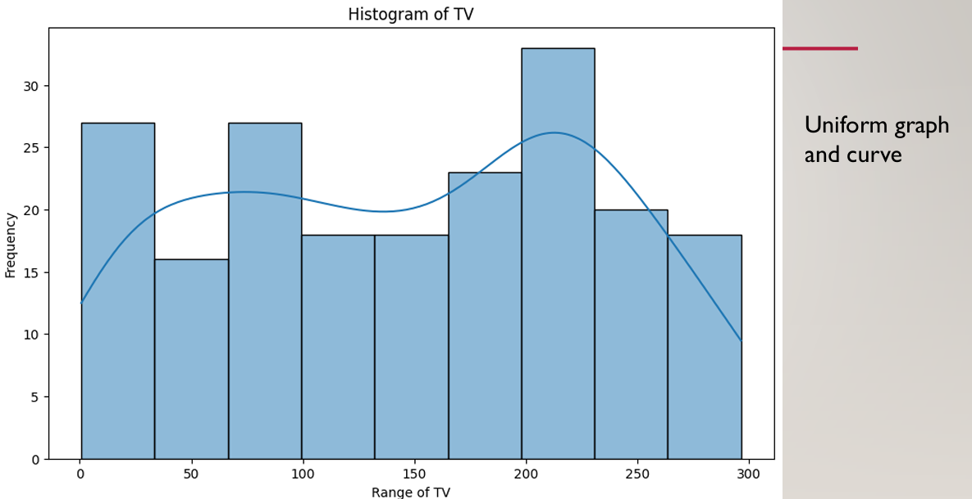
Histogram of TV

Slide 6
Histogram Analysis - Radio
Balanced distribution
Moderate impact on sales
Less variation compared to TV

Slide 7
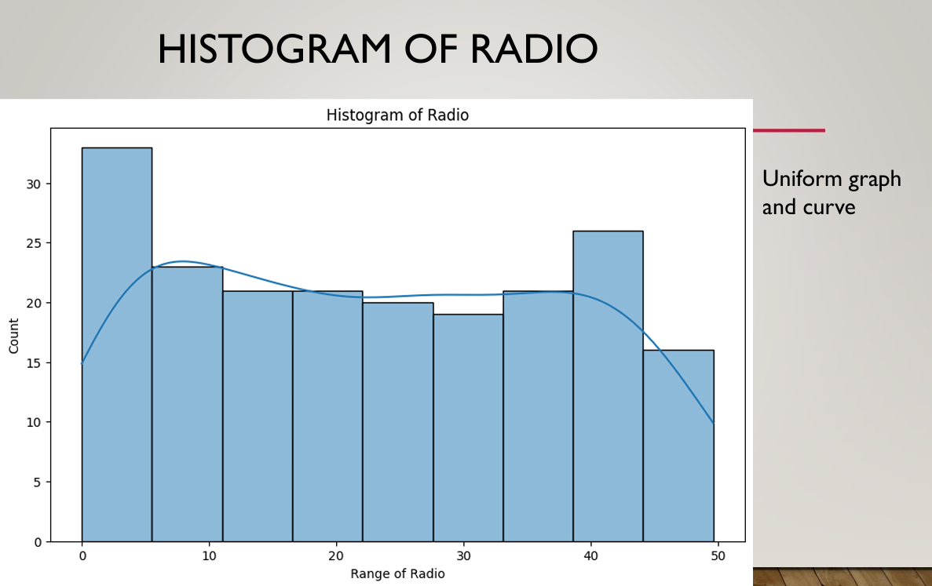

Slide 8
Histogram Analysis - Newspaper
Right-skewed distribution
Lower spending overall
Less impact on sales

Slide 9
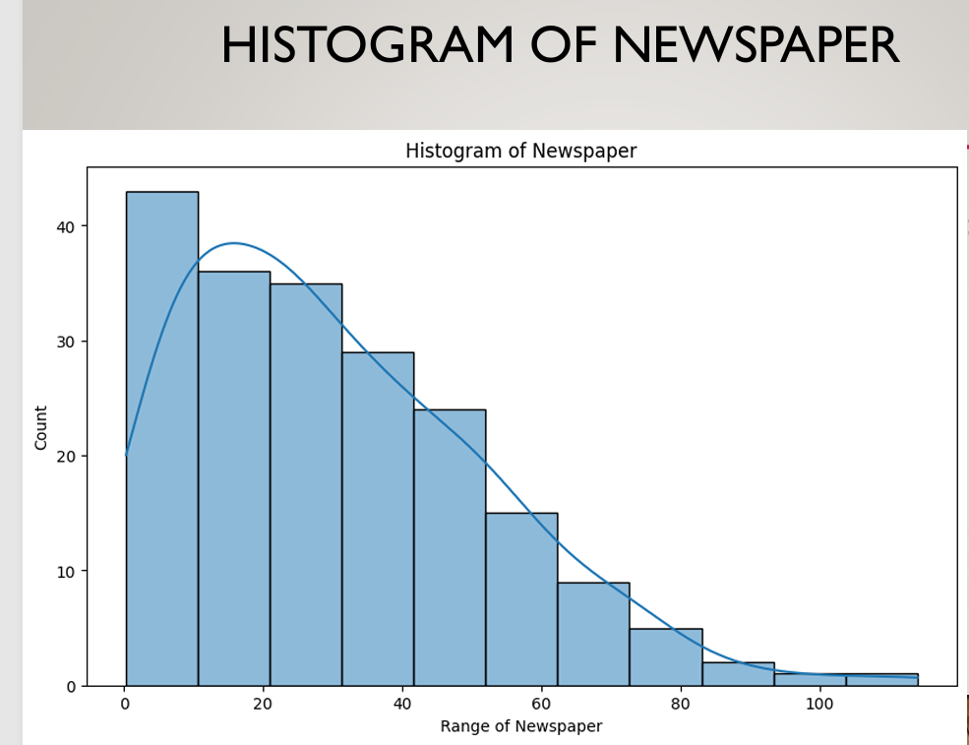

Slide 10
Histogram Analysis - Sales
Bell-shaped curve
Most values around average
Indicates normal distribution

Slide 11
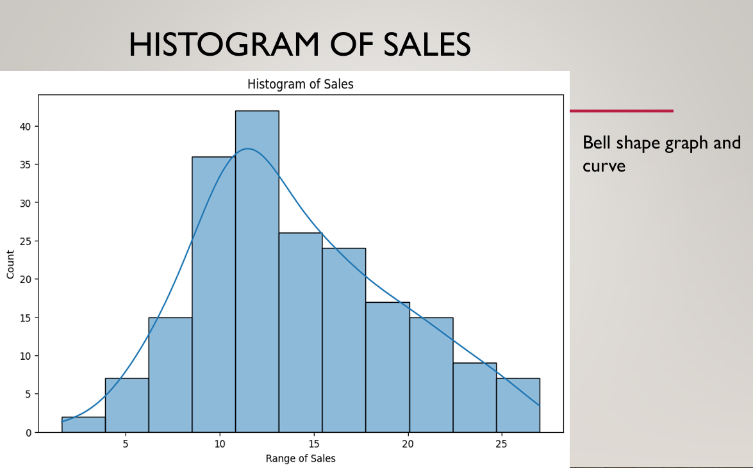

Slide 12
Machine Learning Models
Linear Regression
Polynomial Regression
Train-test split applied

Slide 13
Model Performance
Linear Regression: ~90% R² Score
Polynomial Regression: ~99% R² Score
Polynomial captures non-linearity better

Slide 14
Insights
TV ads contribute most to sales
Radio has moderate contribution
Newspaper has minimal effect

Slide 15
Conclusion
Polynomial model performs best
Data visualization improves understanding
ML helps optimize ad spending

Slide 16
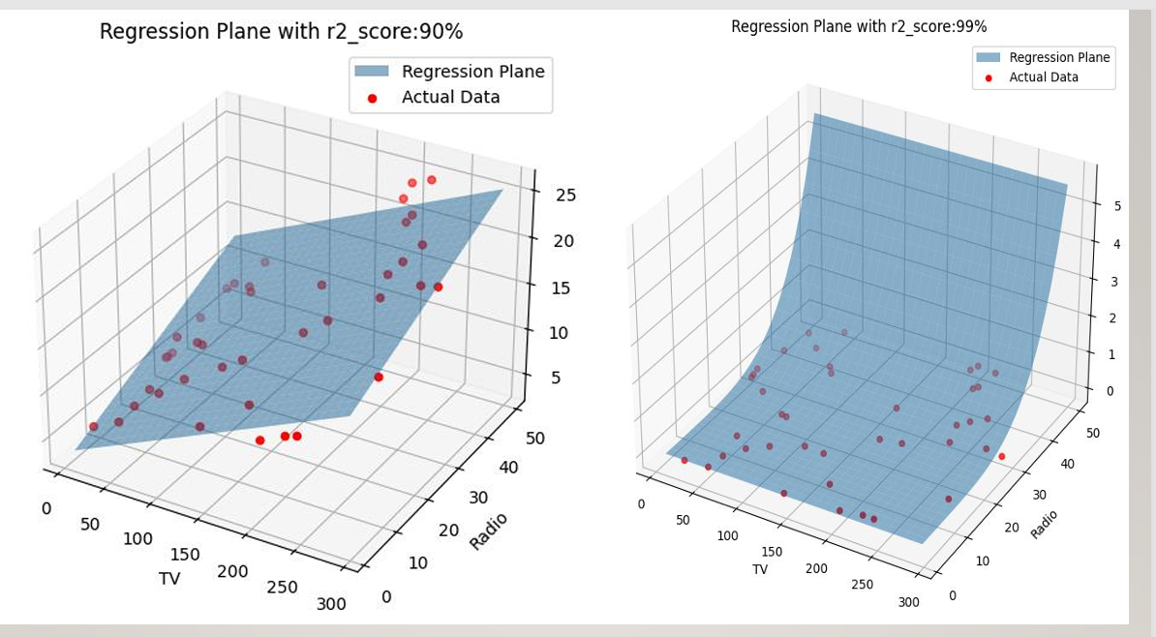

Slide 17
Future Scope
Use advanced models (Random Forest, XGBoost)
Add more real-world features
Deploy as web application

Slide 18
Thank You

